Slide 1
Getting Started with C
Prepared by: Puja Chakraborty

Slide 2
Programming Language: C
High Level Programming Language
Simple
Fast
Machine Independent
Rich Library
Prepared by: Puja Chakraborty

Slide 3
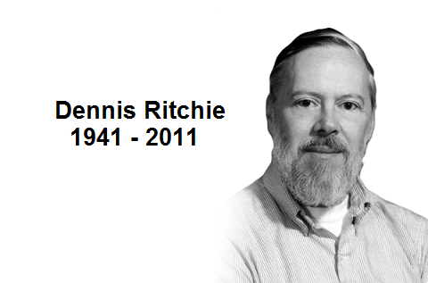
Programming Language: C
Developed by Dennis Ritchie
In 1972
Prepared by: Puja Chakraborty

Slide 4
Basic Structure of a C program
#include<stdio.h>
int main()
{
return 0;
}
Prepared by: Puja Chakraborty

Slide 5
Basic Structure of a C program
Includes the header file that contains different standard i/o functions
#include<stdio.h>
int main()
{
//Rest of you code
return 0 ;
}
Your C program starts executing from here
main() function starts with a curly brace
main() function returns an integer value
(returns 0 after successful completion of the program)
main() function ends with a curly brace
Prepared by: Puja Chakraborty

Slide 6
printf() function
A standard output function
In built library function, defined in stdio.h (header file)
Syntax of printf() function
printf(“The text you want to display”, argument list);
optional
Prepared by: Puja Chakraborty

Slide 7
printf() function
#include<stdio.h>
int main()
{
printf(“Welcome to C Programming”);
return 0;
}
Output of the Program:
Welcome to C Programming
Prepared by: Puja Chakraborty

Slide 8
Tokens in C
Token is
a keyword ,
an identifier ,
a constant,
a string literal or
Symbol.
printf(“Welcome to C Programming”);
How many tokens are present in this statement?
Prepared by: Puja Chakraborty

Slide 9
Tokens in C
Statement:
printf(“Welcome to C Programming”);
Tokens in this statement:
printf
(
“Welcome to C Programming”
)
;
Total 5 tokens are present in this statements.
Prepared by: Puja Chakraborty

Slide 10
Semicolons in C
In a C program, the semicolon is a statement terminator
Each individual statement must be ended with a semicolon
#include<stdio.h>
int main()
{
printf(“Welcome to C Programming”);
return 0;
}
End of statements
Prepared by: Puja Chakraborty

Slide 11
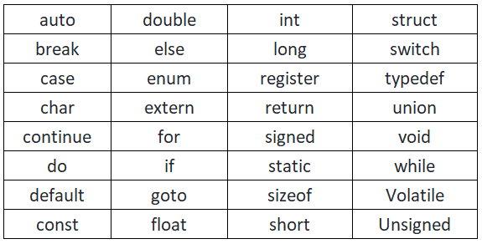
Keywords in C
A keyword is a reserved word.
A keyword can not be used as a variable name, constant name, etc
32 keywords in C
Prepared by: Puja Chakraborty

Slide 12
Identifiers in C
An identifier is a name used to identify a variable, function, or any other user-defined item
Rules of defining identifiers:
An identifier can contain alphabets, digits, and underscore.
An identifier name can start with the alphabet, and underscore only. It can't start with a digit.
No whitespace is allowed within the identifier.
An identifier name must not be any reserved word or keyword, e.g. int, float, etc.
Prepared by: Puja Chakraborty

Slide 13
Identifiers in C
Some valid
identifier
Some invalid
identifier
abc
xyz_12
_a1
myVariable
myVariable2
myIdentifier_3
10abc
double
_a 13
my Variable
my%Variable
my@Identifier_3
Prepared by: Puja Chakraborty

Slide 14
Basic Data Types in C
Data Types
Character
Integer Number
Floating Point Number
Boolean
short
float
int
double
long int
long double
long long int
Prepared by: Puja Chakraborty

Slide 15
Basic Data Types in C
Data Type | Size (Byte) | Range
short int | 2 | -32,768 to 32,767
unsigned short int | 2 | 0 to 65,535
int | 4 | -2,147,483,648 to 2,147,483,647
unsigned int | 4 | 0 to 4,294,967,295
long int | 4 | -2,147,483,648 to 2,147,483,647
unsigned long int | 4 | 0 to 4,294,967,295
long long int | 8 | -(2^63) to (2^63)-1
unsigned long long int | 8 | 0 to 18,446,744,073,709,551,615
Prepared by: Puja Chakraborty

Slide 16
Basic Data Types in C
Data Type | Size (Byte) | Range
signed char | 1 | -128 to 127
unsigned char | 1 | 0 to 255
float | 4 | 1.2E-38 to 3.4E+38
double | 8 | 2.3E-308 to 1.7E+308
long double | 12 | 3.4E-4932 to 1.1E+4932
bool | 1
Prepared by: Puja Chakraborty

Slide 17
Variables in C
A variable is a name of the memory location.
It is used to store data.
Its value can be changed, and it can be reused many times.
It is used to store data.
Syntax to declare a variable
Data_type variable_Name ;
For exapmle:
int x ;
float f1 ;
double f2 ;
Prepared by: Puja Chakraborty

Slide 18
Operators in C
An operator is simply a symbol that is used to perform operations.
Types of operators:
Arithmetic Operator (+ , -, *, /, %)
Relational Operator ( >, <, >=, <=, == , !=)
Logical Operator ( ||, && , !)
Assignment Operator ( =, +=, -=, /=)
Bitwise Operator , Shift Operator, Conditional Operator etc.
Prepared by: Puja Chakraborty

Slide 19
Operators in C (Precedence and Associativity)
Precedence:
If more than one operators are involved in an expression, C language has a predefined rule of priority for the operators.
This rule of priority of operators is called operator precedence.
Associativity:
If two operators of same precedence (priority) is present in an expression, Associativity of operators indicate the order in which they execute.
Prepared by: Puja Chakraborty

Slide 20
Operators in C (Precedence and Associativity)
Category
Operator
Associativity
High
Postfix
() [] -> . ++ - -
Left to right
Multiplicative
* / %
Left to right
Additive
+ -
Left to right
Precedence
Shift
<< >>
Left to right
Relational
< <= > >=
Left to right
Equality
== !=
Left to right
Bitwise AND
&
Left to right
Bitwise OR
|
Left to right
Logical AND
&&
Left to right
Logical OR
||
Left to right
Low
Assignment
= += -= *= /= %=
Right to left
Prepared by: Puja Chakraborty

Slide 21
Format Specifier in C
The Format specifier is a string used in the formatted input and output functions.
Data Type | Format Specifier
short | %hd
int | %d or, %i
long int | %ld
long long int | %lld
unsigned short | %hu
unsigned int | %u
unsigned long long int | %llu
Data Type | Format Specifier
float | %f
double | %lf
long double | %Lf
char | %c
char sequence (string) | %s
Hexadecimal integer | %x
Octal Integer | %o
Prepared by: Puja Chakraborty

Slide 22
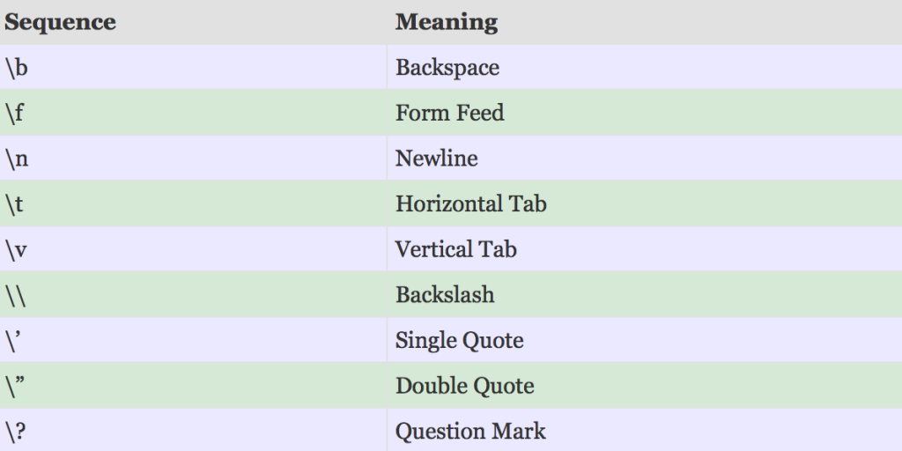
Escape Sequence in C
An escape sequence is a sequence of characters that doesn't represent itself when used inside string literal or character
Prepared by: Puja Chakraborty

Slide 23
scanf() function
The scanf() function is used for input. It reads the input data from the console.
Syntax of scanf() function
scanf(“Format String”, argument list);
Prepared by: Puja Chakraborty

Slide 24
scanf() function
Syntax of scanf() function
scanf(“Format String”, argument list);
Taking input (one integer):
scanf(“%d”, &a);
Taking input (two float):
scanf(“%f %f”, &x, &y);
Taking input (one integer and one char):
scanf(“%d %c”, &n, &c);
Prepared by: Puja Chakraborty

Slide 25
Thank
You
Credit: This template was created by SlidesGo, including the icons by Flaticons and infographics and images by Freepiks.
Prepared by: Puja Chakraborty

Slide 26
Instructor Information:
Puja Chakraborty
Lecturer
Department of Computer Science and Engineering
Premier University
Chattogram, Bangladesh
Email: puja.csecu@gmail.com
Contact: +880-1863-927559
Prepared by: Puja Chakraborty

